Slide 1
C# is awesome!
Sanjar Akhmedov

Slide 2




About me
Sanjar Akhmedov
Software Engineer
Silk Road Professionals
3 years of experience
/Akhmedov_Sanjar
/Akhmedov_Sanjar
/SanjarSoftdev

Slide 3
Params Collections
New link methods
Agenda
The field keyword
New Lock Object
Partial properties

Slide 4
Params Collections
Starting with C# 13, the params modifier supports any collection type that implements IEnumerable<T>, not just arrays

Slide 5
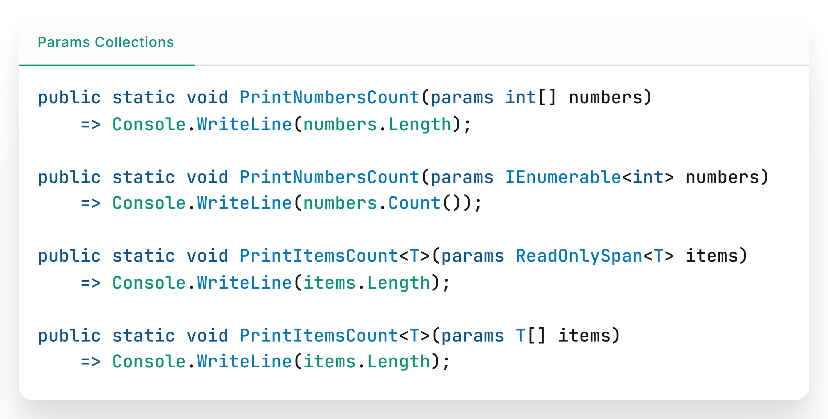

Slide 6
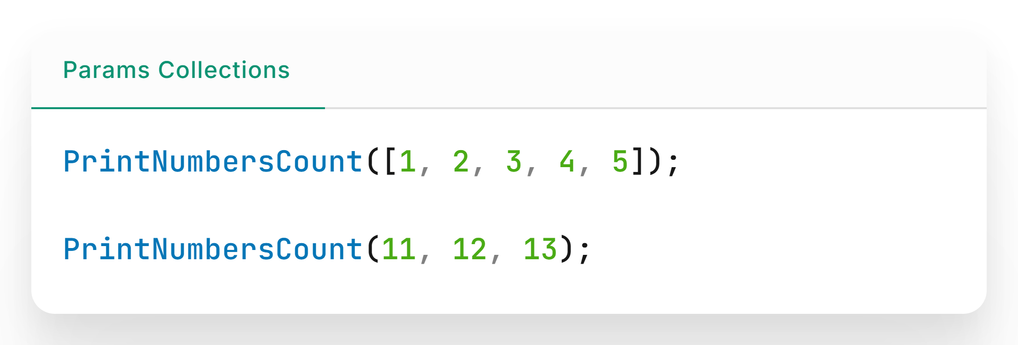
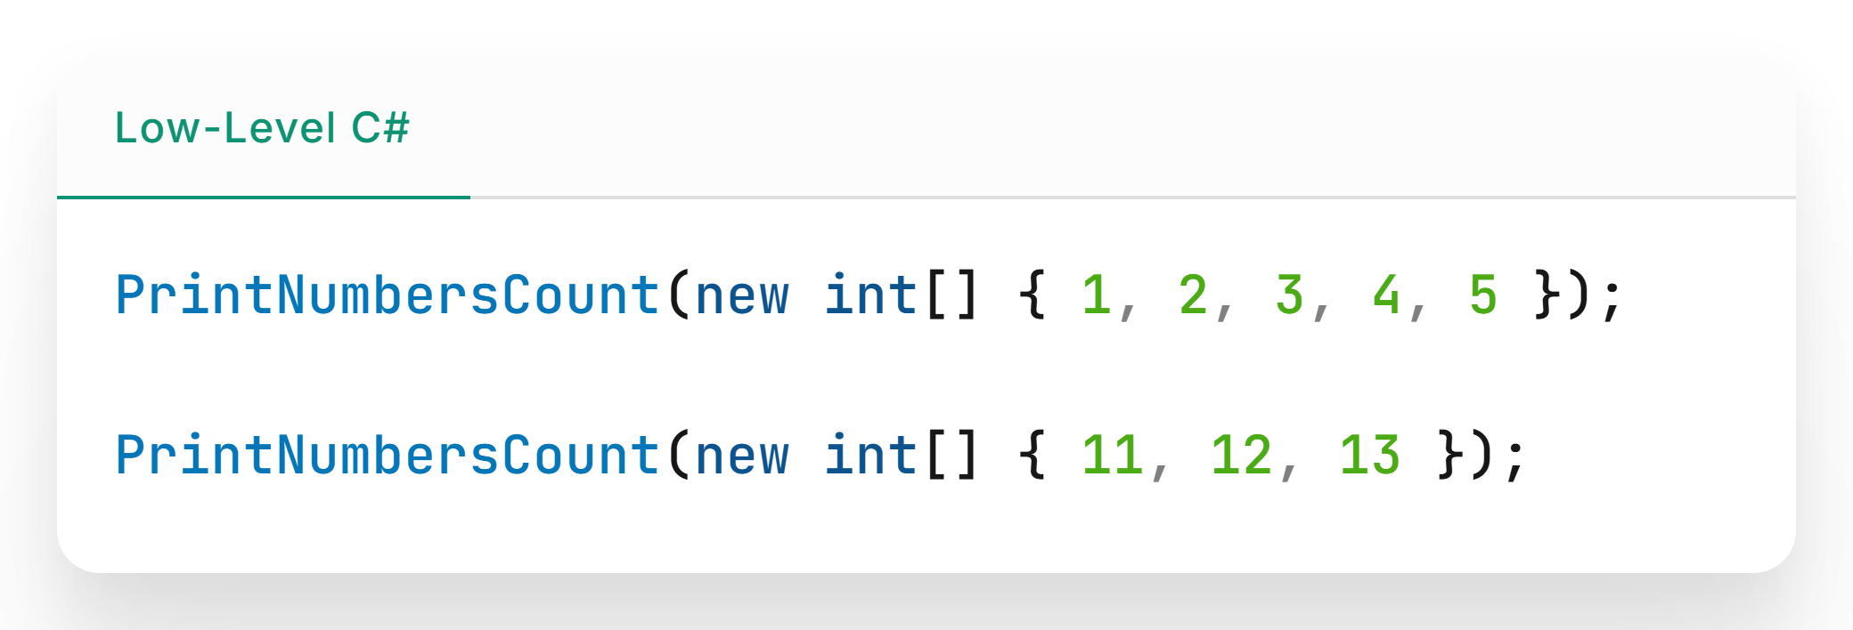

Slide 7
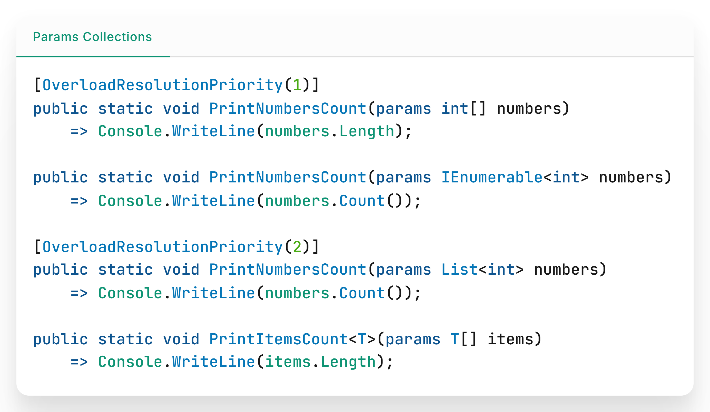

Slide 8
New linq methods
Introducing new methods: CountBy, AggregateBy, and Index. These methods boost performance and simplify common data tasks.

Slide 9
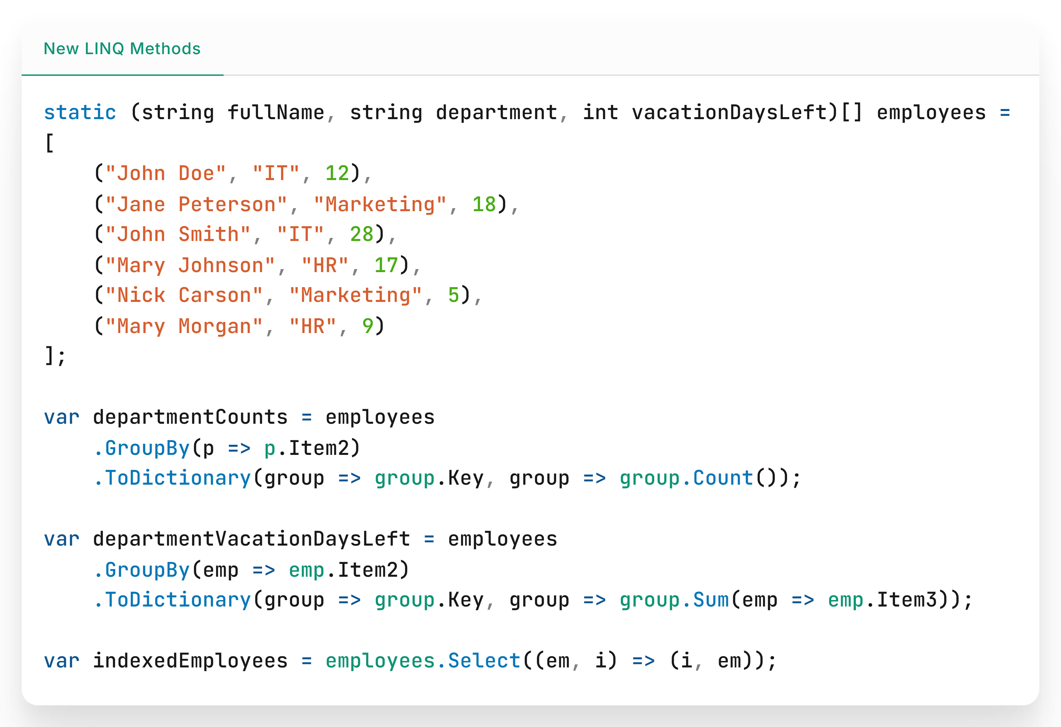

Slide 10
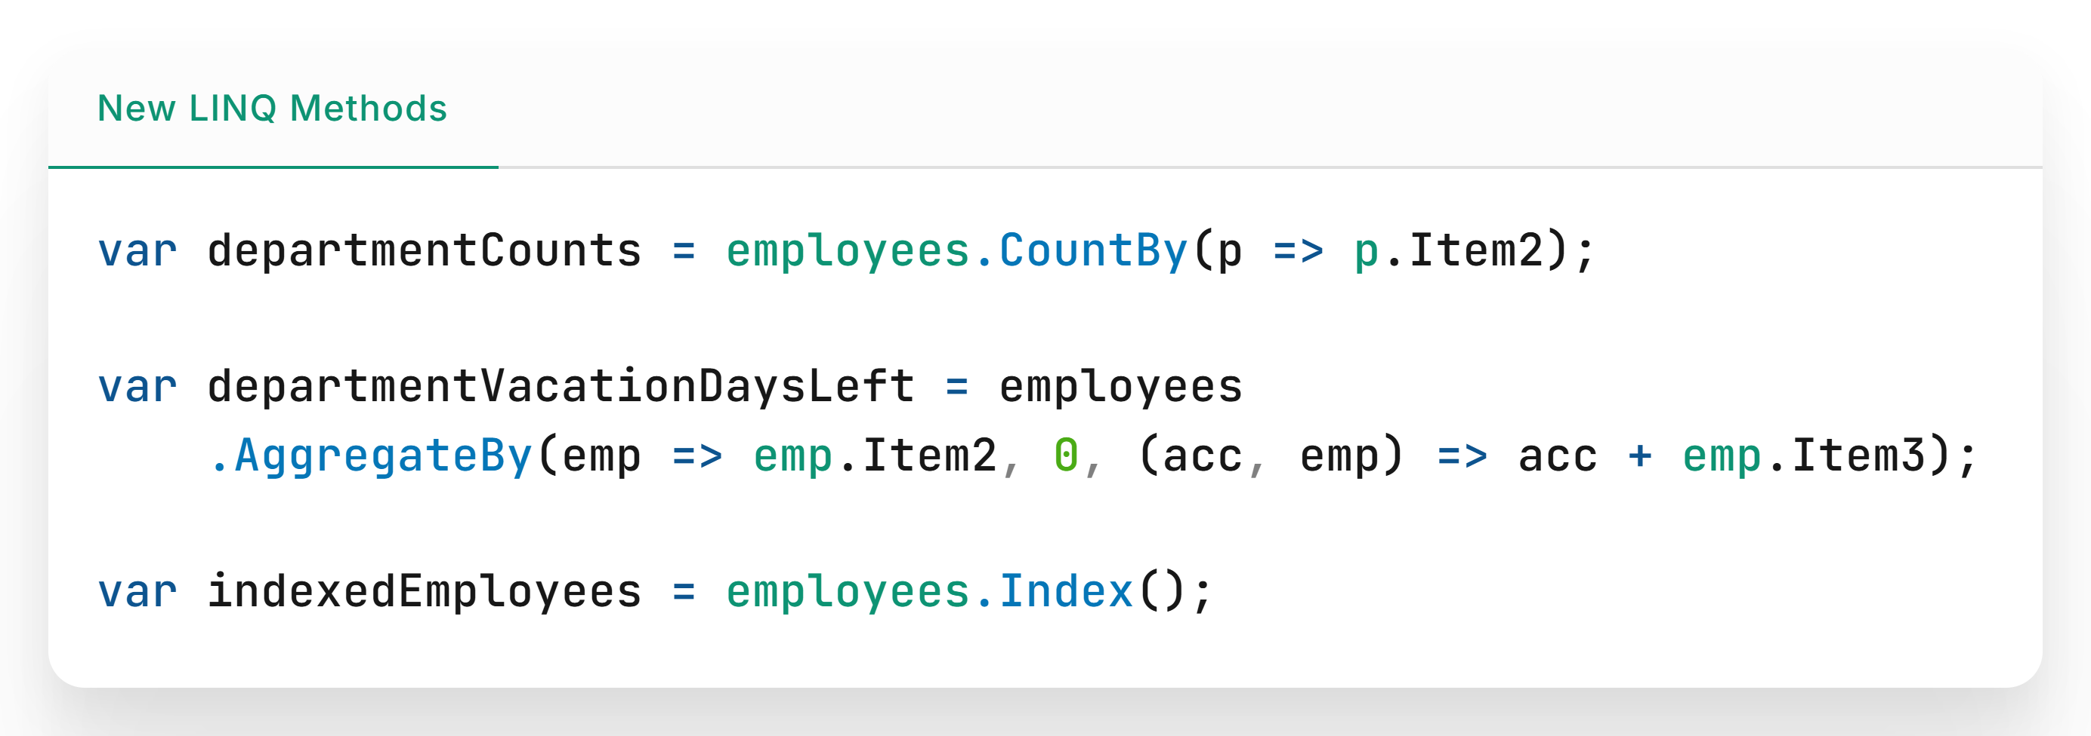

Slide 11
The field keyword
C# 13 introduces the field keyword, which lets you access a property's backing field directly.
This simplifies adding custom logic like validation, default values, computations without manually defining the backing field.

Slide 12
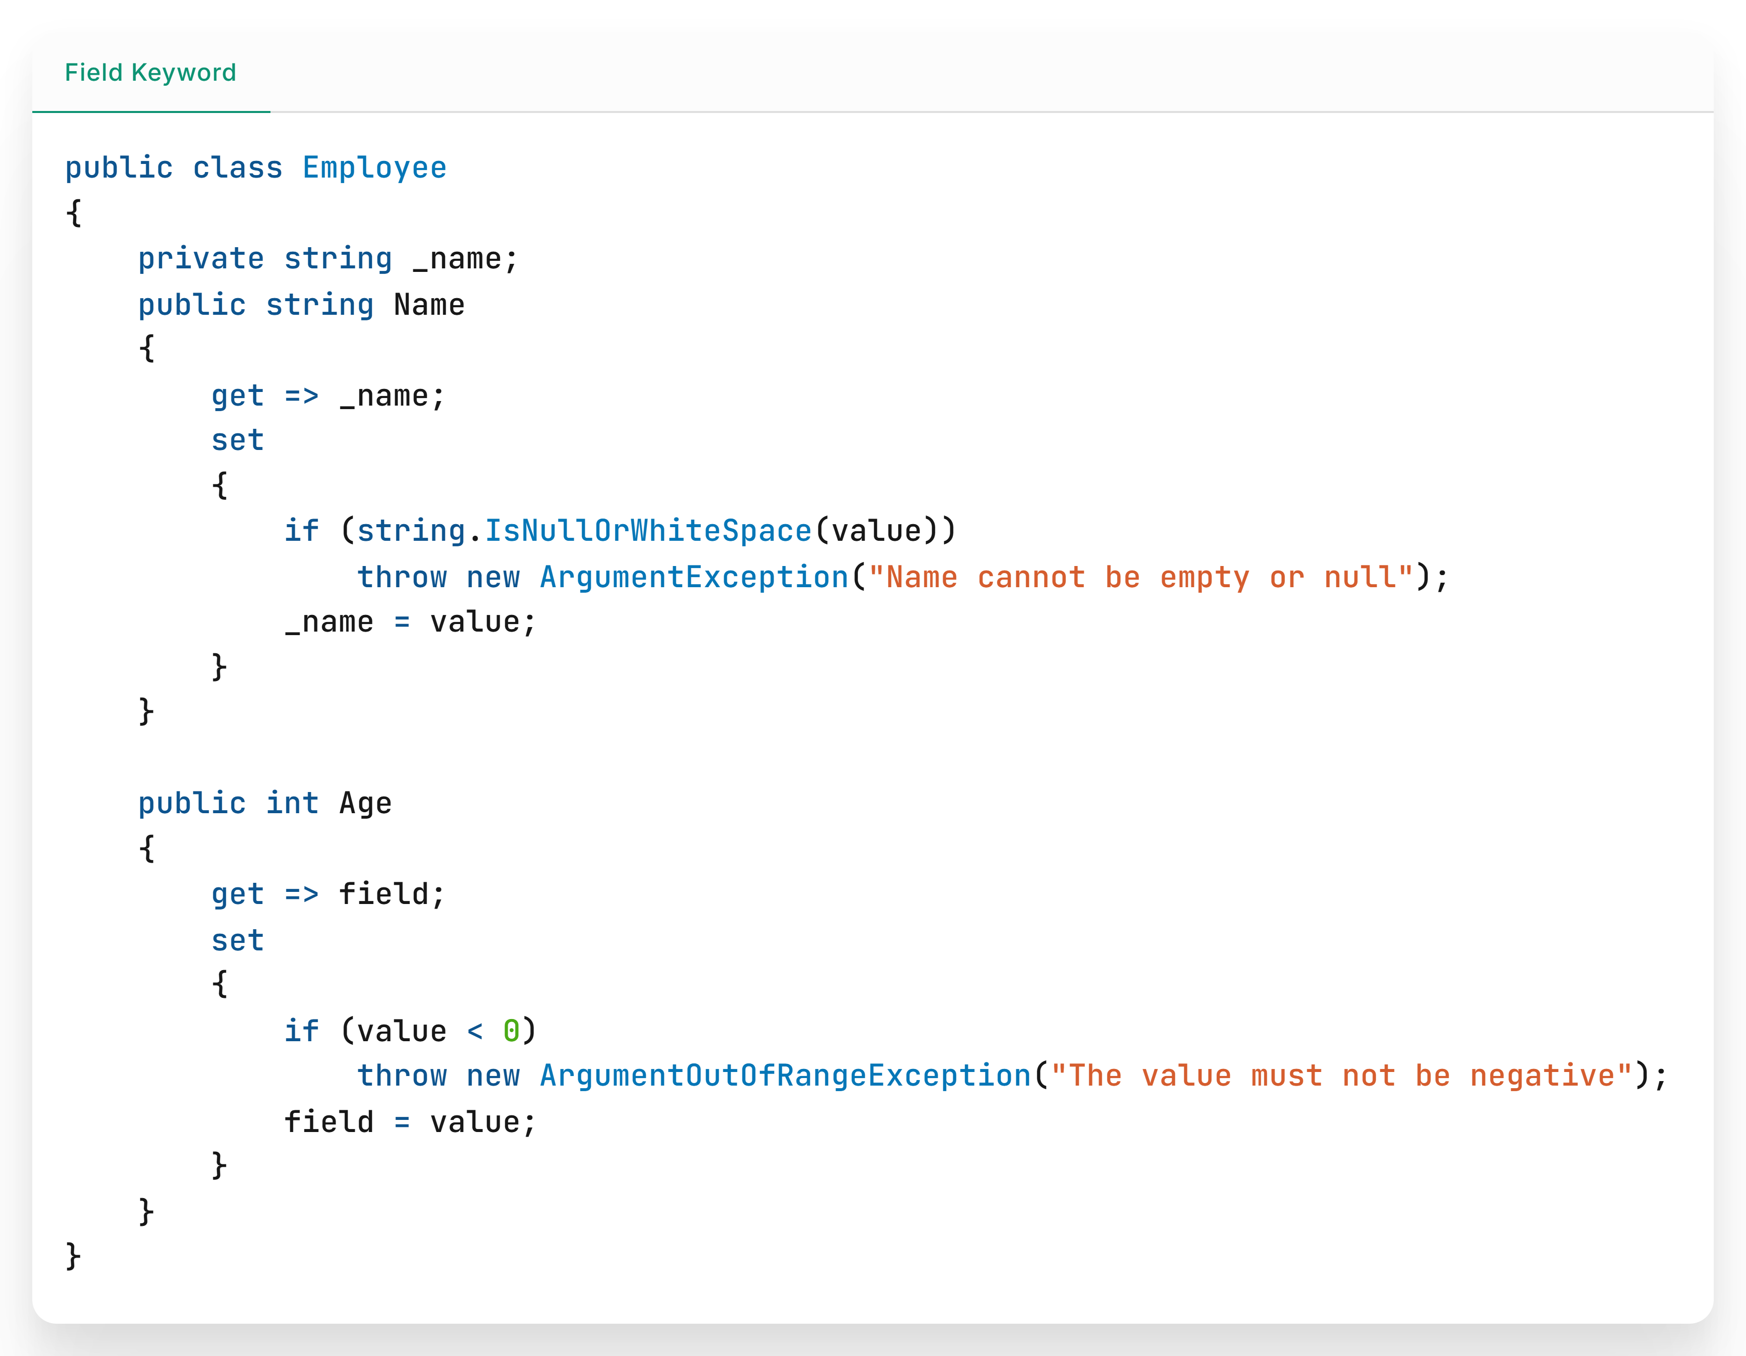

Slide 13
New Lock Object
The new System.Threading.Lock in C# 13 makes thread synchronization easier and safer, helping your code run smoothly and reliably in multithreaded environments.

Slide 14
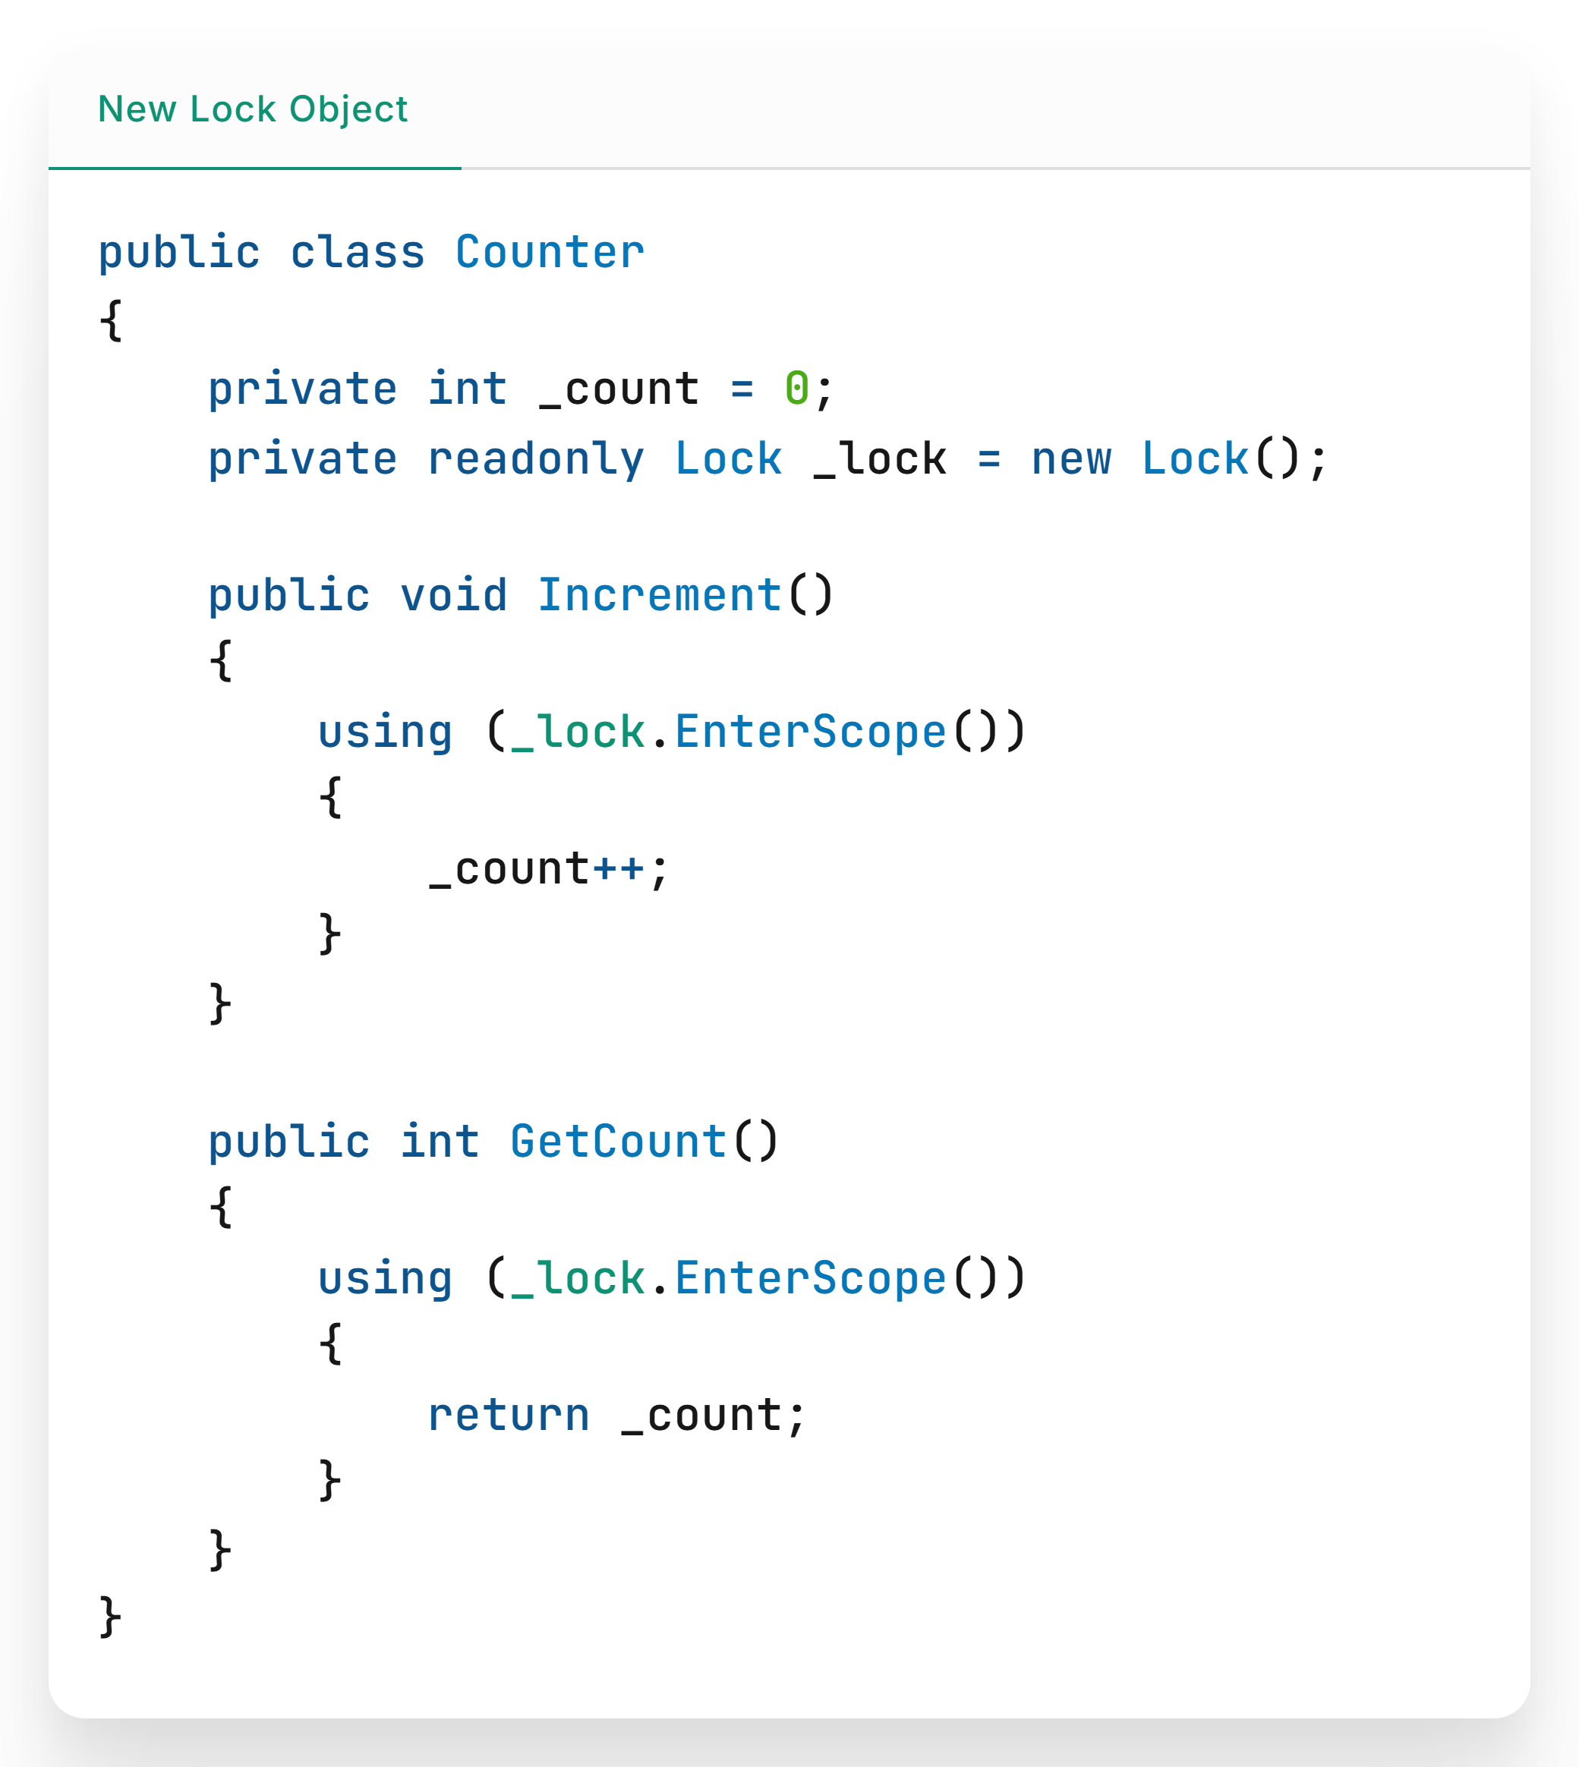

Slide 15
Partial properties
Partial properties split class implementation across files, making code modular and easier to manage.

Slide 16
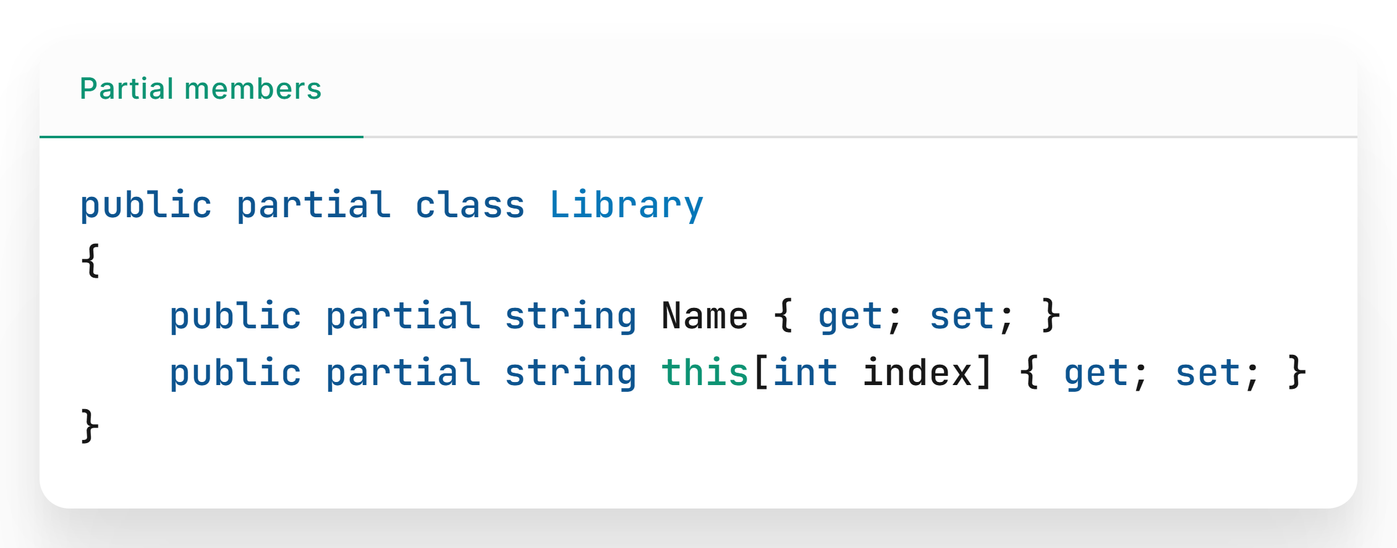

Slide 17
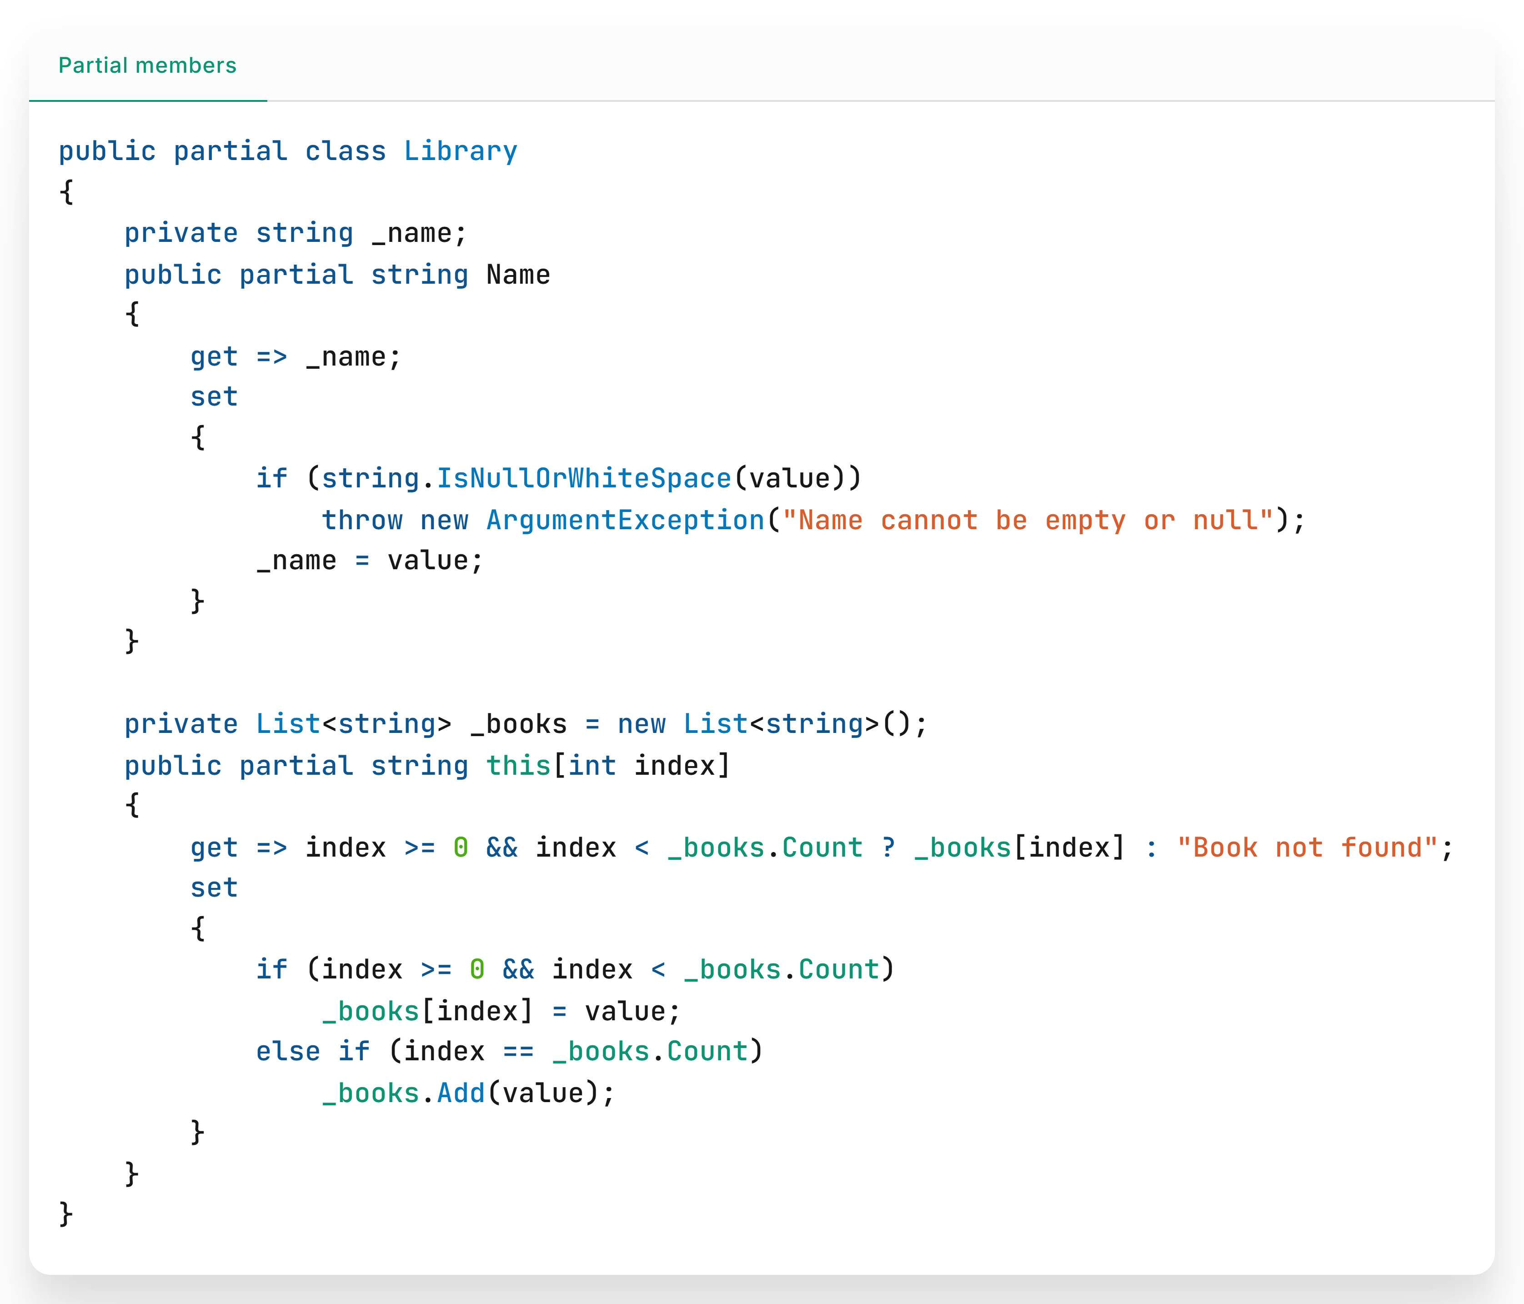

Slide 18


Demo repository

Slide 19
Get .NET 9
Download .NET 9 aka.ms/get-dotnet-9

Slide 20
Thank you

